Slide 1

Wireless networks
Connectivity
Routing strategies
Discovery mechanism for routes
Challenges
Mobile Move and changes their location
Impact on communication
Speed, Direction, Energy Level
6: Wireless and Mobile Networks
6-<number>

Slide 2
Cellular Networks
Working
Ist G, 2G, GSM, 3G, 4G, next G N
Security of wireless networks/mobile networks
You have to write a short survey/review research paper
Existing techniques should be compare and analyze.
Pros and cons
6: Wireless and Mobile Networks
6-<number>

Slide 3

Share your topic with class CR before next week.
Appreciate a latest topic
Node to AP the rest of Nw tang media
6: Wireless and Mobile Networks
6-<number>

Slide 4

6: Wireless and Mobile Networks
6-<number>

Slide 5



wireless hosts
laptop, PDA, IP phone
run applications
may be stationary (non-mobile) or mobile
  wireless does not always mean mobility
network
infrastructure
6: Wireless and Mobile Networks
6-<number>

Slide 6
base station
typically connected to wired network
relay - responsible for sending packets between wired network and wireless host(s) in its “area”
  e.g., cell towers 802.11 access points
network
infrastructure
6: Wireless and Mobile Networks
6-<number>

Slide 7
wireless link
typically used to connect mobile(s) to base station
also used as backbone link
multiple access protocol coordinates link access
various data rates, transmission distance
network
infrastructure
6: Wireless and Mobile Networks
6-<number>

Slide 8
infrastructure mode
base station connects mobiles into wired network
handoff: mobile changes base station providing connection into wired network
network
infrastructure
6: Wireless and Mobile Networks
6-<number>

Slide 9
Ad hoc mode
no base stations
nodes can only transmit to other nodes within link coverage
nodes organize themselves into a network: route among themselves
6: Wireless and Mobile Networks
6-<number>

Slide 10

single hop
multiple hops
host connects to
base station (WiFi,
WiMAX, cellular)
which connects to
larger Internet
host may have to
relay through several
wireless nodes to
connect to larger
Internet
infrastructure
(e.g., APs)
no base station, no
connection to larger
Internet. May have to
relay to reach other
a given wireless node
MANET, VANET
no
infrastructure
no base station, no
connection to larger
Internet (Bluetooth,
ad hoc nets)
6: Wireless and Mobile Networks
6-<number>

Slide 11

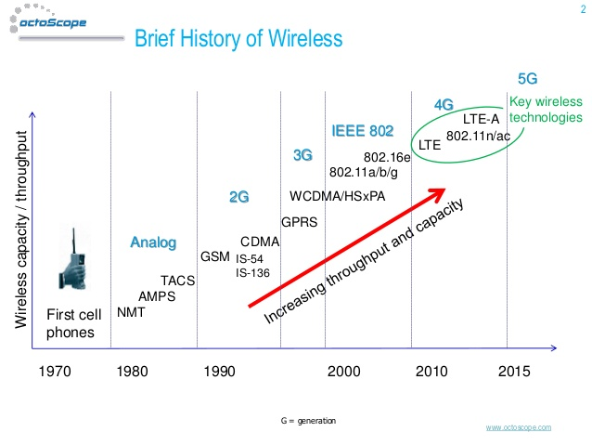
6: Wireless and Mobile Networks
6-<number>

Slide 12

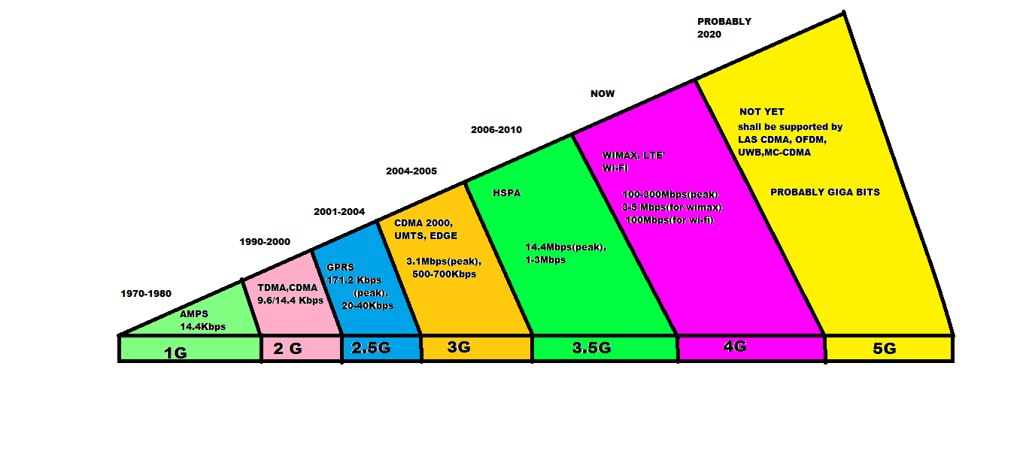
6: Wireless and Mobile Networks
6-<number>

Slide 13
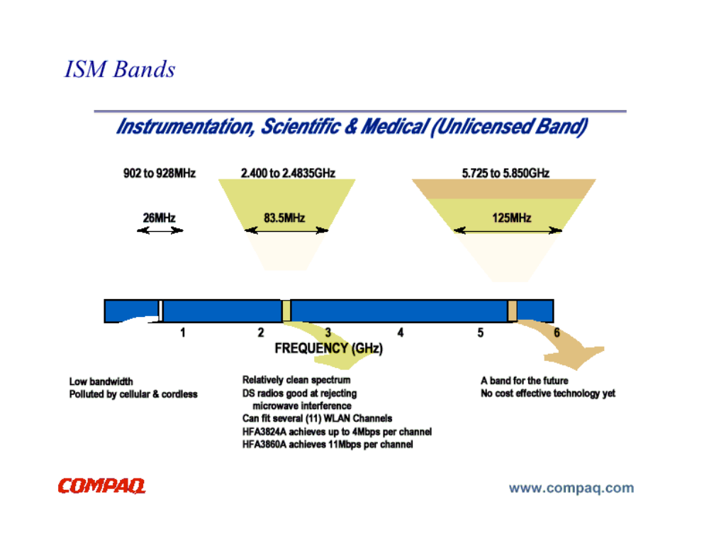

54 Mbps
802.11{a,g}
5-11 Mbps
.11 p-to-p link
802.11b
1 Mbps
802.15
3G
384 Kbps
UMTS/WCDMA, CDMA2000
2G
56 Kbps
IS-95 CDMA, GSM
Indoor
10 – 30m
Outdoor
50 – 200m
Mid range
outdoor
200m – 4Km
Long range
outdoor
5Km – 20Km
6: Wireless and Mobile Networks
6-<number>

Slide 14

Setting up of fixed access points and backbone infrastructure is not always viable
  Infrastructure may not be present in a disaster area or war zone
  Infrastructure may not be practical for short-range radios; Bluetooth (range ~ 10m)
Ad hoc networks:
  Do not need backbone infrastructure support
  Are easy to deploy
  Useful when infrastructure is absent, destroyed or impractical

Slide 15

Cellular Networks | Ad Hoc Wireless Networks
Fixed infrastructure-based | Infrastructureless
Guaranteed bandwidth (designed for voice traffic) | Shared radio channel (more suitable for best-effort data traffic)
Centralized routing | Distributed routing
Circuit-switched (evolved toward packet switching) | Packet-switched (evolving toward emulation of circuit switching)
Seamless connectivity (low call drops during handoffs) | Frequent path breaks due to mobility
High cost and time of deployment | Quick and cost-effective deployment
Reuse of frequency spectrum through geographical channel reuse | Dynamic frequency reuse based on carrier sense mechanism

Slide 16
Cellular Networks | Ad Hoc Wireless Networks
Application domains include mainly civilian and commercial sectors | Application domains include battlefields, emergency search and rescue operations, and collaborative computing
High cost of network maintenance (backup power source, staffing, etc.) | Self-organization and maintenance properties are built into the network
Mobile hosts are of relatively low complexity | Mobile hosts require more intelligence (should have a transceiver as well as routing/switching capability)
Major goals of routing and call admission are to maximize the call acceptance ratio and minimize the call drop ratio | Main aim of routing is to find paths with minimum overhead and also quick reconfiguration of broken paths
Widely deployed and currently in the fourth generation of evolution | Several issues are to be addressed for successful commercial deployment even though widespread use exists in defense

Slide 17

Personal area networking
  cell phone, laptop, ear phone, wrist watch
Military environments
  soldiers, tanks, planes
Civilian environments
  taxi cab network
  meeting rooms
  sports stadiums
  boats, small aircraft
Emergency operations
  search-and-rescue
  policing and fire fighting

Slide 18

Limitations of the Wireless Network
  packet loss due to transmission errors
  variable capacity links
  frequent disconnections/partitions
  limited communication bandwidth
  Broadcast nature of the communications
Limitations Imposed by Mobility
  dynamically changing topologies/routes
  lack of mobility awareness by system/applications
Limitations of the Mobile Computer
  short battery lifetime
  limited capacities

Slide 19

Multiple wireless senders and receivers create additional problems (beyond multiple access):
A
B
C
C
A’s signal
strength
C’s signal
strength
B
A
Hidden terminal problem
B, A hear each other
B, C hear each other
A, C can not hear each other
means A, C unaware of their interference at B
space
Signal fading:
B, A hear each other
B, C hear each other
A, C can not hear each other interfering at B
6: Wireless and Mobile Networks
6-<number>

Slide 20

Application
  new applications and adaptations
Transport
  congestion and flow control
Network
  addressing and routing
Link
  media access and handoff
Physical
  transmission errors and interference

Slide 21

  802.1: High Level Interface
  802.2: Logical Link Control
  802.3: CSMA/CD Networks
  802.4: Token Bus Networks
  802.5: Token Ring Networks
  802.6: Metropolitan Area Networks
  802.7: Broadband Networks
  802.8: Fiber Optic Networks
  802.9: Integrated Data and Voice Networks
  802.10 Virtual LANs
  802.11 Wireless LANs
  802.12 Communication media\
  802.14 Data transport over traditional cable TV network
  802.15; personal area networks
  802.16 Wireless Local Loops

Slide 22
802.1 MANAGEMENT
802.2 LOGICAL LINK CONTROL
802.1 BRIDGING
DATA
LINK
LAYER
802.3
MEDIUM
ACCESS
(Ethernet)
PHYSICAL
802.4
MEDIUM
ACCESS
(token bus)
PHYSICAL
802.5
MEDIUM
ACCESS
(token ring)
PHYSICAL
802.11
MEDIUM
ACCESS
(WLAN)
PHYSICAL
802.12
MEDIUM
ACCESS
(Gigabit
LAN)
PHYSICAL
. . .
PHYSICAL
LAYER
Notes:
The IEEE 802.1 Working Group is chartered to concern itself with and develop standards and recommended practices in the following areas: 802 LAN/MAN architecture, internetworking among 802 LANs, MANs and other wide area networks, 802 Security, 802 overall network management, and protocol layers above the MAC & LLC layers.
The 802.1 working group has four active task groups: Interworking, Security, Audio/Video Bridging and Data Center Bridging.

Slide 23

Wireless Fidelity (Wi-Fi) manufacturers may use to brand certified products that belong to a class of wireless local area network (WLAN) devices based on the IEEE 802.11 standards.
The term Wi-Fi is often used as a synonym for IEEE 802.11 technology.
Notes:
Wireless Ethernet Compatibility Alliance (WECA)

Slide 24
Short Wave Radio
FM Broadcast
AM Broadcast
Television
Infrared wireless LAN
Audio
Cellular (840MHz)
NPCS (1.9GHz)
Extremely
Low
Very
Low
Low
Medium
High
Very
High
Ultra
High
Super
High
Infrared
Visible
Light
Ultra-
violet
X-Rays
902 - 928 MHz
26 MHz
2.4 - 2.4835 GHz
83.5 MHz
(IEEE 802.11b,
Bluetooth)
5 GHz
(IEEE 802.11a,
HiperLAN,
HiperLAN2)
Notes:
HiperLAN (High Performance Radio LAN) is a Wireless LAN standard. It is a European alternative for the IEEE 802.11 standards
HiperLAN/1 features:
range 50 m
slow mobility (1.4 m/s)
supports asynchronous and synchronous traffic
sound 32 kbit/s, 10 ns latency
video 2 Mbit/s, 100 ns latency
data 10 Mbit/s
HiperLAN/2 uses the 5 GHz band and up to 54 Mbit/s data rate.[

Slide 25

  IEEE 802.11a
    PHY Standard : 8 channels : 54 Mbps
  IEEE 802.11b
    PHY Standard : 3 channels : 11 Mbps :
  IEEE 802.11d
    MAC Standard : operate in variable power levels :
  IEEE 802.11e
    MAC Standard : QoS support
  IEEE 802.11f
    Inter-Access Point Protocol
  IEEE 802.11g
    PHY Standard: 3 channels : OFDM and PBCC
  IEEE 802.11h
    Supplementary MAC Standard: TPC and DFS
  IEEE 802.11i
    Supplementary MAC Standard: Alternative WEP
  IEEE 802.11p
    Vehicular Networks

Slide 26

Access Point placement depends on wired network availability
Obstructions make it difficult to provide total coverage of an area
Site surveys are performed to determine coverage areas
Security Concerns: Location of Access points in companies etc..
Each Access Point has limited range

Slide 27

If nodes move out of range of the access point (Infrastructure Mode)
OR nodes are not in direct range of each other (Ad Hoc Mode)
Then communication is not possible!!

Slide 28


Multi-hop Infrastructure Access
Multi-hop Ad Hoc Network
OR

Slide 29


Nodes might be out of range of the access point, BUT in range of other nodes.
The nodes in range of the access point could relay packets to allow out of range nodes to communicate.

Slide 30

If communication is required between two nodes which are out of range of each other, intermediary nodes can forward the packets.
Source
Destination

Slide 31

Details of 802.11
Protocol Stack
  Logical Link Control
Contention-free service
Contention service
  Point Coordination Function (PCF)
MAC Layer
  Distributed Coordination Function (DCF)
2.4 GHz
FHSS
1 Mbps
2 Mbps
5 GHz
OFDM
6, 9, 12, 18, 24, 36, 48, 54 Mbps
2.4 GHz
DSSS
1, 2, 5.5, 11 Mbps
2.4 GHzOFDM
1, 2, 5.5, 11 Mbps
6, 9, 12, 18, 24, 36, 48, 54 Mbps
2.4 GHz
DSSS
1 Mbps
2 Mbps
Infrared
1 Mbps
2 Mbps
PHY Layer
IEEE 802.11
Access Points
IEEE 802.11a
Ad hoc
IEEE 802.11b
IEEE 802.11g

Slide 32

Distributed Coordination Function (DCF)
  Medium access is contended by all the members of the network.
  DCF requires a station wishing to transmit to listen for the channel status.
  DCF uses the CTS/RTS clearing technique to reduce the possibility of collisions.
Point Coordination Function (PCF)
  It resides in a point coordinator also known as AP, to coordinate the communication within the network.
  The PCF allows stations to transmit frames after a shorter interval.
6: Wireless and Mobile Networks
6-<number>

Slide 33

  AP admin chooses frequency for AP
  interference possible: channel can be same as that chosen by neighboring AP!
host: must associate with an AP
  scans channels, listening for beacon frames containing AP’s name (SSID) and MAC address
  selects AP to associate with
  may perform authentication
  will typically run DHCP to get IP address in AP’s subnet
6: Wireless and Mobile Networks
6-<number>

Slide 34

BBS 1
BBS 2
BBS 1
BBS 2
AP 1
AP 2
AP 1
1
AP 2
1
1
2
2
2
3
3
4
H1
H1
Passive Scanning:
beacon frames sent from APs
association Request frame sent: H1 to selected AP
association Response frame sent: H1 to selected AP
Active Scanning:
Probe Request frame broadcast from H1
Probes response frame sent from APs
Association Request frame sent: H1 to selected AP
Association Response frame sent: H1 to selected AP

Slide 35

Many issues need to be addressed in order to design an efficient MAC protocol
Hidden Terminal Problem
  Station A can hear B but not C, and station C can hear station B but not A
  First, assume A is sending to B
  When C is ready to transmit, it does not detect carrier and thus commences transmission; this produces a collision at B
A
B
C

Slide 36

A
B
C
Hidden terminals
  A sends to B, C cannot detect A’s transmission
  C wants to send to B, C senses a “free” medium (CS fails)
  Collision at B, A cannot detect the collision (CD fails)
  A is “hidden” for C

Slide 37

A
B
C
D
Exposed terminals
  B sends to A, C wants to send to D
  C senses carrier, finds medium in use and has to wait
  A is outside the radio range of C, therefore waiting is not necessary
  C is “exposed” to B

Slide 38

MACA uses signaling packets for collision avoidance
  RTS (request to send)
  -Sender request the right to send from a receiver with a short RTS packet before it sends a data packet
  CTS (clear to send)
    -Receiver grants the right to send as soon as it is ready to receive
Signaling packets contain
  Sender address
  Receiver address
  Duration
Variants of this method are used in IEEE 802.11

Slide 39

MACA avoids the problem of hidden terminals
  A and C want to send to B
  A sends RTS first
  C waits after receiving
  CTS from B
MACA avoids the problem of exposed terminals
  B wants to send to A, C to another terminal
  Now C does not have
  to wait, as it cannot
  receive CTS from A
RTS
A
B
C
CTS
CTS
RTS
RTS
A
B
C
CTS

Slide 40

Synchronization - finding and staying with a WLAN - synchronization functions
Power Management - sleeping without missing any messages - power management functions
Roaming - functions for joining a network - changing access points - scanning for access points
Management information base

Slide 41

Mobile devices are battery powered
power management is important for mobility
802.11 power management protocol
Allows transceiver to be off as much as possible
Transparent to existing protocols

Slide 42

Allow idle stations to go to sleep - station’s power save mode stored in AP
APs buffer packets for sleeping stations - AP announces which stations have frames buffered - traffic indication map (TIM) sent with every beacon
Power saving stations wake up periodically

Slide 43

Mobile stations may move - beyond the coverage area of their AP - but within range of another AP
Re association allows station to continue operation.

Slide 44

Station decides that link to its current AP is poor.
Station uses scanning function to find another AP
Station sends Re-association Request to new AP
If Re-association Response is successful
Then station has roamed to the new AP - else station scans for another AP
If AP accepts Re-association Request
AP indicates Re-association to the distributed system
- Distributed system information is updated

Slide 45

Scanning is required for many functions - finding and joining a network - finding a new access point during roaming
Passive scanning - find networks simply by listening for beacons
Active scanning - on each channel send a probe and wait for probe response

